Slide 1
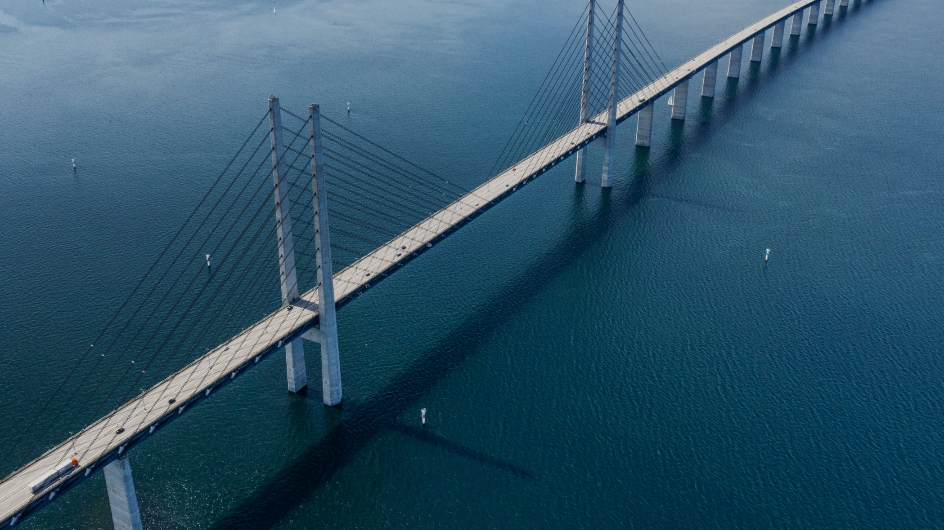

Reinforcement Federated Learning
Place suitable background image on dark background.
Set image transparency to allow for white text if possible (in this example 20%).
Let yellow logo be on top. Shift for dark logo if image is light.
If you move logo – be sure to hide background elements.
Images: Preferably explore our dropbox or use images from this template
Layout: Header
Notes:
Introduce ourselves And we will present about our weeks investingating stategies on how to genenerate a global model using federated reinfocement learning

Slide 2
Use layouts for structure and margins – even if you do something different. This layout is based on “Five – six bullets”
Layout: Five – six bullets
We will show a quick overview of:
Reinforcement learning
Federated Learning
How they are combined in practice
Our objective
Notes:
And to do so we will begin with some quick overviews; mainly about the projects background; mainly...

Slide 3



Reinforcement Learning
Place suitable background image on dark background.
Set image transparency to allow for white text if possible (in this example 20%).
Let yellow logo be on top. Shift for dark logo if image is light (dark logo lies behind yellow in this slide).
Layout: Header
Notes:
Describe RL in short and easy to understand steps using the image
So you might with that description be able to see what Reinforcement learning is commonly used for Like Self-Driving cars, with it, it becomes possible for an intelligent agent to test new actions/aproches (if it is simulated), change course on failure, and thrive
Its shortcomings (lot of data, lot of computation), that is however not as large of a problem because...

Slide 4


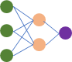

Place suitable background image on dark background.
Set image transparency to allow for white text if possible (in this example 20%).
Let yellow logo be on top. Shift for dark logo if image is light (dark logo lies behind yellow in this slide).
Layout: Header
Federated Learning
Notes:
And this is what federated learning can solve
Describe fed in short and easy to understand steps using the image (machine learning technique that trains an algorithm across multiple decentralized edge devices)
What it makes possible (catch/utilize unused data/compute), Make a similes with us in this call only using 1/10 of our cpu/gpu
What it is used for (free compute, world-wide representation)

Slide 5
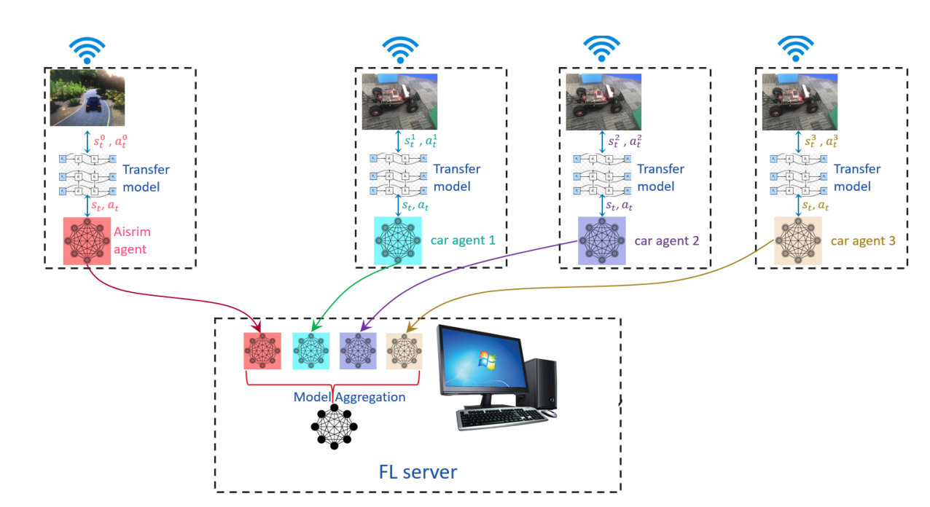
Federated Reinforcement Learning in practice
Place suitable background image on dark background.
Set image transparency to allow for white text if possible (in this example 20%).
Let yellow logo be on top. Shift for dark logo if image is light (dark logo lies behind yellow in this slide).
Layout: Header
Notes:
Current state of fed-rl (can solve the problem of not enough data/computation),
One paper kickstarted it (federated transfer reinforcement learning for autonomous driving), where they train autonomous driviing with federated system to solve the problem with data transfer restrictions
growing field, so there is still a lot to do, so we wanted to contribute,

Slide 6
Snake environment
Layout: Three bullets colored background
Short about what we did
DQN Model
Federated Learning
+
+
Dynamic and easily iterated upon
Simple DQN reinforcement learning model
Applied federated learning to reinforcement learning
Notes:
So what did we contribute?
Say what the game snake is about
And with an implementation of these systems we could do further fundamental research of what is possible on this growing field of federated reinforcement learning.

Slide 7
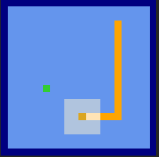
Testing environment
Place suitable background image on dark background.
Set image transparency to allow for white text if possible (in this example 20%).
Let yellow logo be on top. Shift for dark logo if image is light (dark logo lies behind yellow in this slide).
Layout: Header
Notes:
Why we chose snake because; we needed an environment that we could easily add additional rules to unlike tictactoe etc, others have been successful in training snake with rl

Slide 8
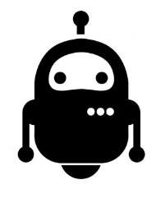
Our *Agents
Place suitable background image on dark background.
Set image transparency to allow for white text if possible (in this example 20%).
Let yellow logo be on top. Shift for dark logo if image is light (dark logo lies behind yellow in this slide).
Layout: Header
DQN
?
?
?
?
PPO
Notes:
Explain how we feelt like multiple types of agents were not necessary for our research, We only choose to implement DQN (Lin,CNN),
yet we still made it modular enough to easily add in the future:
* PPO (Proximal Policy Optimization)
* AlphaGo route (test multiple actions)
* PolicyGradient
* AdvantageActorCriticAgent
* HamiltonianCycleAgent
* SupervisedLearningAgent
* BreadthFirstSearchAgent (hardcoded a* algorythm)

Slide 9

Federated Reinforcement Learning
Place suitable background image on dark background.
Set image transparency to allow for white text if possible (in this example 20%).
Let yellow logo be on top. Shift for dark logo if image is light (dark logo lies behind yellow in this slide).
Layout: Header
Notes:
For research purposes we trained locally (simulated federated learning).
Explain how we feelt like multiple types of fedsystems were not necessary for our research, since they work interchangeably, so we only choose to implement one of the simpler fed-systems: fedaverage
We ofcourse still made the repo modular enough to easily add them in the future when/if we come back to it
Something we were discussing was implementing gosspip learning (P2P) (peer to peer)

Slide 10

Results
Place suitable background image on dark background.
Set image transparency to allow for white text if possible (in this example 20%).
Let yellow logo be on top. Shift for dark logo if image is light.
Layout: Header (alt 2 sub)
Notes:
As a general trend going forward, going to the right means longer training time unless specified otherwise

Slide 11
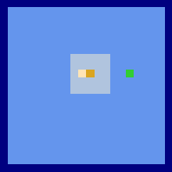
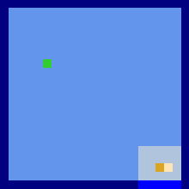
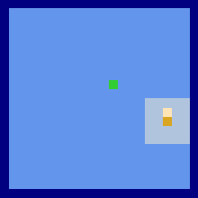
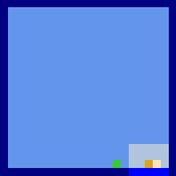
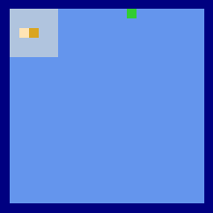
No federated
On food environment
40000
80000
100000
140000
180000
Notes:
What do we see here? (not federated, only food)
Reflect on it: 20 min per 10k episodes on Tesla K80 GPU Lot of episodes lot of data (benchmark to show that our agent/model works)

Slide 12
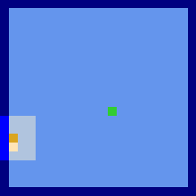
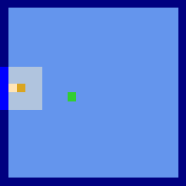
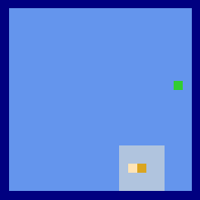
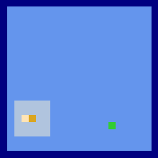
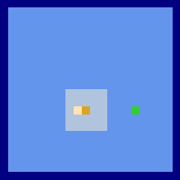
Federated On food environment
40000
70000
90000
120000
140000
Notes:
Using that information we tried experimenting with federated learning
What do we see here? (federated, only food)
Reflect on it: Training was done locally on the same hardware, so episodes took longer since they trained two agents but yielded better results, we saw only a small decreece in performance. Both the last example without federated and this one got roughly the same amount of flops. Thinking in real world applications the amount of compute and data federated can yield we would suggest it is beneficial if it can be implemented.

Slide 13
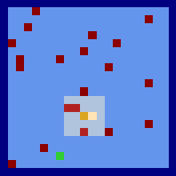
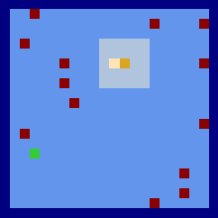
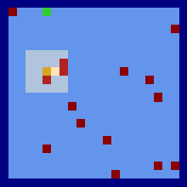
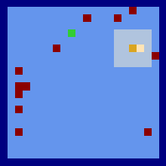
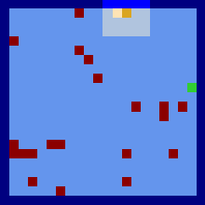
No Federated On red mine environment
40000
80000
100000
140000
180000
Notes:
What do we see here? (not federated, now with mines that give lower penalty than walls since the snake only loses a body part)
Reflect on it: Our agent can learn from more advance reward functions and environments, although it preforms slightly worse.

Slide 14
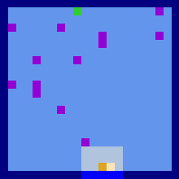
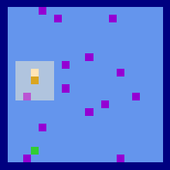
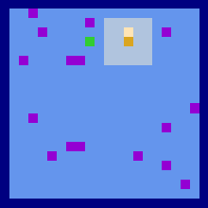
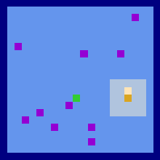
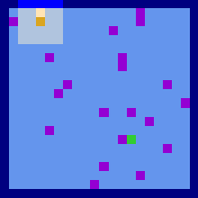
Federated On purple mine environment
40000
70000
90000
120000
140000
Notes:
What do we see here? (federated, also with mines but of different color (visual) than the last one)
Reflect on it: We see a slight increase in performance but it might be a fluke (randomness) We also see that our federated learning system seems to translate as well as our non-federated counterpart on a more difficult environment.

Slide 15
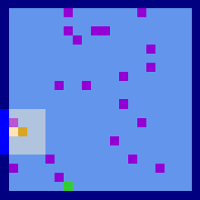
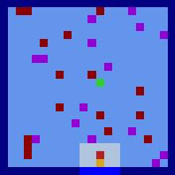
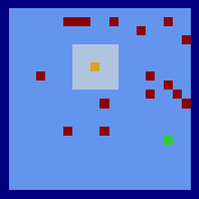
Use layouts for structure and margins – even if you do something different. This layout is based on “Three bullets”
Careful with symbols – we don’t want to use MS Office Clipart or a mashup of proprietary icons
Layout: Three bullets
Federated On purple mine environment
* Same model for all examples
Training environment and testing environment are the same
Testing environment contains new information
Testing environment only contains new information
Notes:
What do we see here? (Our agent that we saw right before this slide (fed+purple mine) being tested on 3 different environments) note that all three examples are of the same model with the same weights the only thing that differ are the environments and how they act
Going from the left we see:

Slide 16
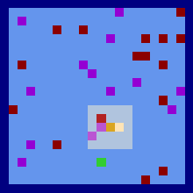
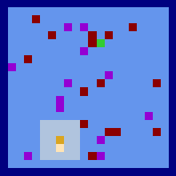
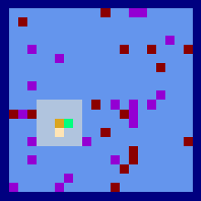
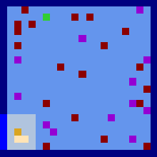
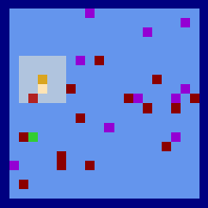
Fed purple or red mines trained from start
40000
70000
90000
120000
140000
Notes:
What do we see here? (federated, with both mines) but it is trained on only one seperatly
Reflect on it: We see a noticeable decrease in performance but an transfer of knowledge between the two agent, since seeing both red and purple mines were never in the training data only one at a time seperatly for each agent

Slide 17
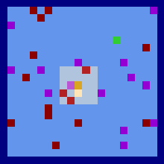
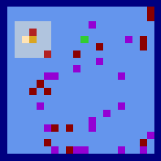
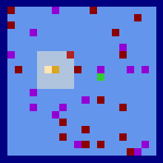
Fed purple and red mines trained from already trained models
* Initially aggregated from two pretrained models of 195000 episode count each of only purple and red mines separately
+5000
+15000
+25000
Notes:
What do we see here? (initialized with fed average of two of our best models for purple and red mine separately)
Reflect on it: Initialy it seems to be of no use, its reacting irrationally But with only some more training we see a spike in performance This would conclude that the aggregation does not result in a randomly initialized model

Slide 18
Federated reinforcement learning
Layout: Three bullets colored background
Conclusions:
Transfer learning
Late Aggregation of models
Federated reinforcement learning works in a research setting
Aggregation of multiple models with differing policies results in a joint policy
Aggregating pretrained models accelerates learning in new environments

Slide 19
Further research
Have agents compete and learn from each other in the same environment
Apply different epsilon greedy policies for a network of federated snakes to see if we can accelerate training
Append rules to the game (tiles)

